Slide 1

Presentation On
Speckle Noise Reduction, Segmentation, Prediction Of Abnormality From
Breast Ultrasound Images
Indian Insitute Of Technology Kharagpur
UNDER THE GUIDENCE: Presented By:
Dr. Nirmalya Ghosh Ashwani Kumar singh
(Assistant Professor) (21MM62R06)
Department Of Electrical Engineering Ankur Kumar Jaiswal
IIT Kharagpur (21MM62R08)

Slide 2
OUTLINES:
INTRODUCTION
OBJECTIVE
SPECKLE NOISE REDUCTION
IMAGE SEGMENTATION
CLASSIFICATION USING MACHINE LEARNING
RESULTS
CONCLUSION
REFERENCES

Slide 3
INTRODUCTION
Ultrasound Imaging is one of the key medical diagnostic tools because of a number of advantages:
non-invasive
free of radiation
economical and real-time.
US images have unique challenges that include low imaging quality and high variability
Deep learning and Machine learning in medical US analysis have involved various tasks, such as classification, segmentation, detection.

Slide 4
OBJECTIVE
Project have three objectives :
Remove the speckle noise from US image.
Segment out the cancerous Region.
US images classification using Machine Learning .

Slide 5
SPECKLE NOISE REDUCTION
Speckle Noise is caused by the scattering of waves from the surface of small structures within a certain tissue.
An Autoencoder is an unsupervised learning technique for neural networks that learns efficient data representations (encoding) by training the network to ignore signal “noise.”
It Extract features by compressing the image in the encoder part of the network. After the operation is performed, in the decoding part. The compressed image is restored to its original size.
Autoencoder can be used for image denoising, image compression.

Slide 6
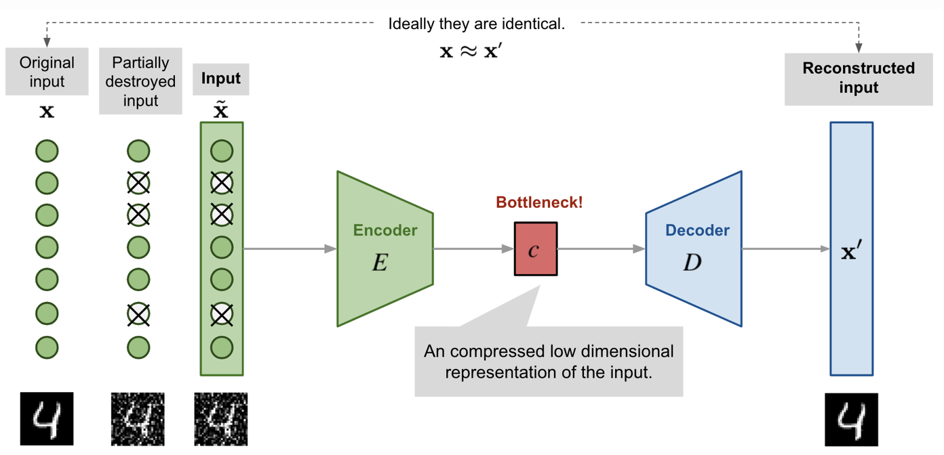
Autoencoder Block Diagram

Slide 7
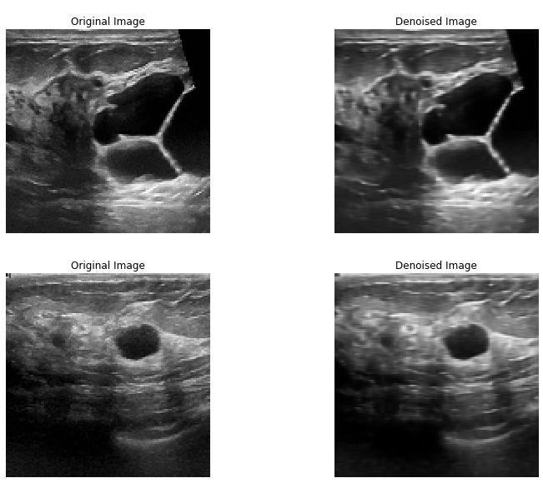
Autoencoder Output

Slide 8
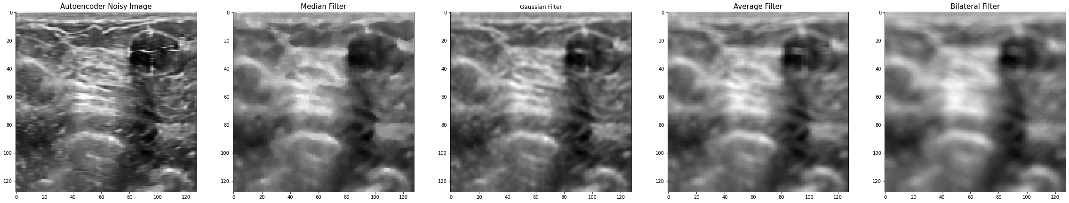
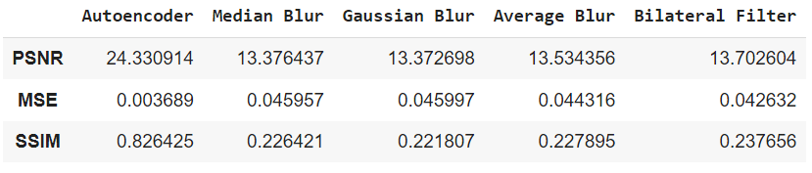
Comparison with other filters
Parameter

Slide 9
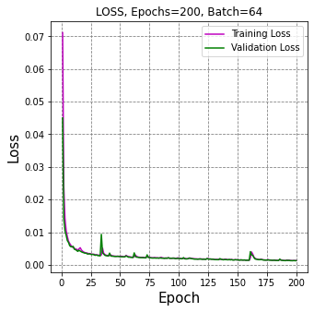
Loss Vs Epochs
Loss Vs Epoch

Slide 10
SEGMENTATION USING U-NET
U-Net evolved from convolution neural network to process the biomedical images. The task is to localise the area of abnormality. The reason it is able to localise the area and distinguish the borders is by doing classification on every pixel.
It is basically a convolutional neural network consisting of contracting and expansive paths. It consists of the repeated application of two 3x3 convolutions , each followed by a rectified linear unit (ReLU) and a 2x2 max pooling operation with stride 2 for downsampling.
At each downsampling step, we double the number of feature channels

Slide 11
Every step in the expansive path consists of an upsampling of the feature
mapfollowed by a 2x2 convolution (“up-convolution”) that halves the
number of feature channels, a concatenation with the correspondingly
cropped feature map from the contracting path, and two 3x3 convolutions,
each followed by a ReLU.
At the final layer, a 1x1 convolution is used to map each 64-component feature
vector to the desired number of classes.
In total the network has 23 convolutional layers.

Slide 12


Slide 13
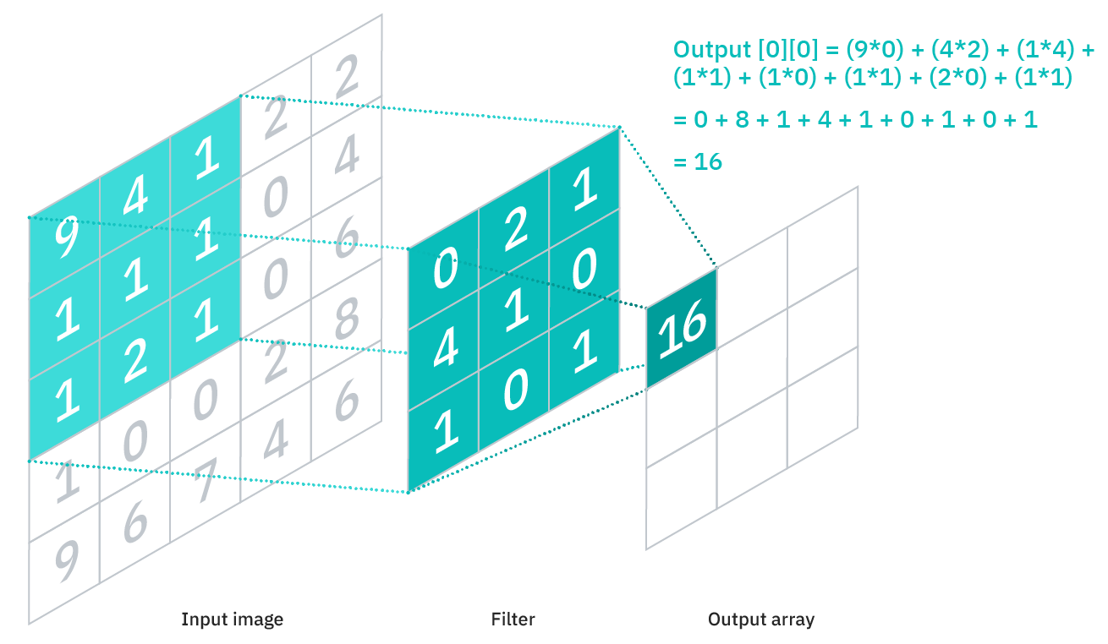
Convolution :
The convolution operation calculates the sum of the element-wise multiplication
between the input matrix and kernel matrix. The depth of the image increases.
A convolution operation forms a many-to-one relationship.

Slide 14
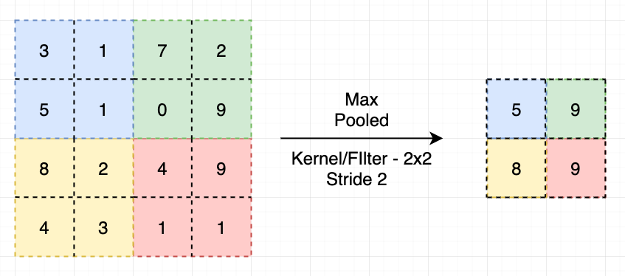
MaxPooling:
The idea to do maxpooling is to retain the key information corresponding to
Significant features that model should learn and at the same time reduce the
Image size by getting rid of insignificant information.

Slide 15
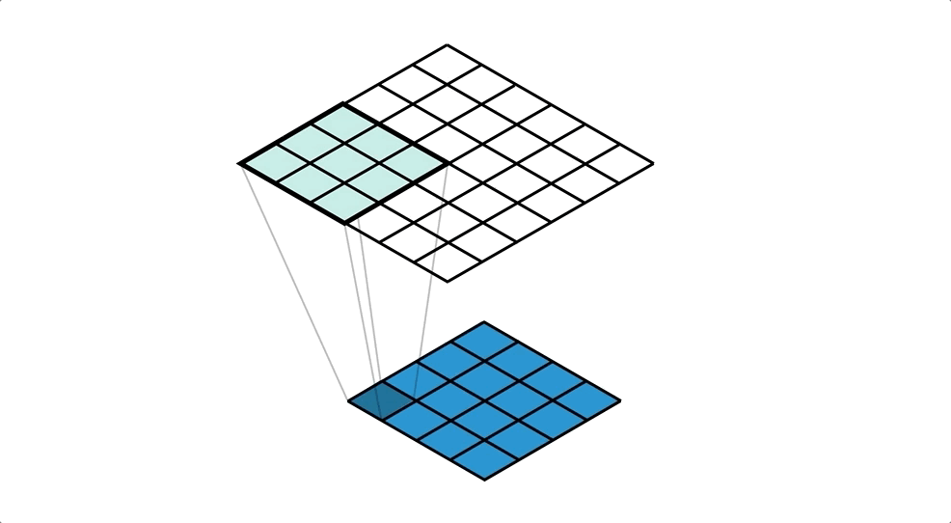
Transposed Convolution or Up Sampling
The transposed convolution operation forms the same connectivity as the normal
convolution but in the backward direction.
It expands the size of images. Basically, it does some padding on the original image followed by a convolution operation.
It maintains the one to many relations.

Slide 16
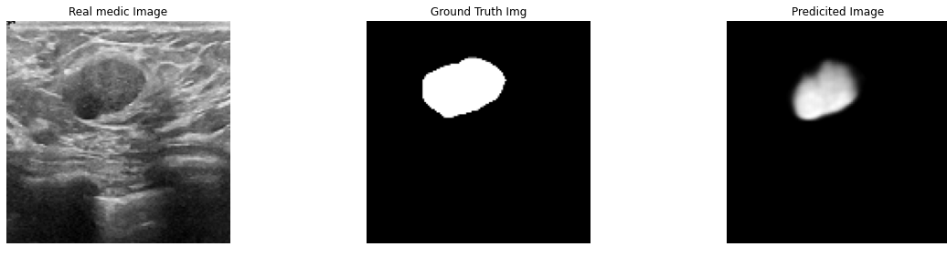
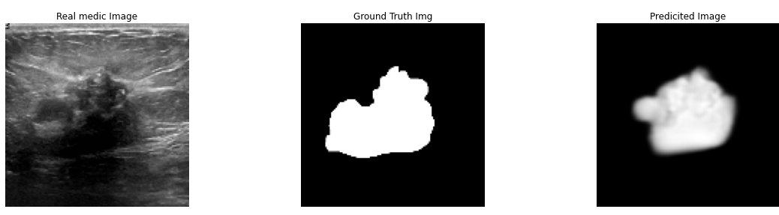
Segmentation Result:

Slide 17
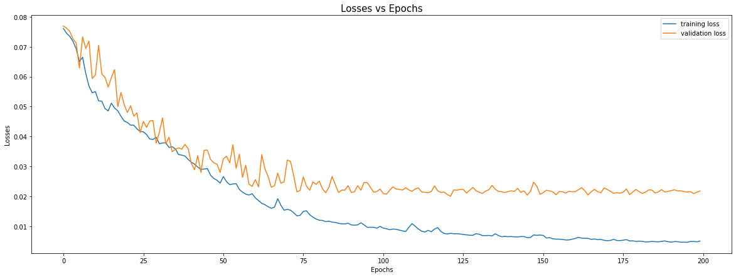
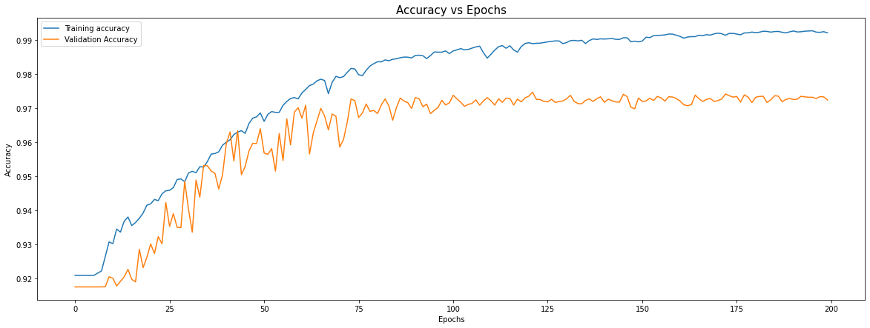
Loss Vs Epochs
Accuracy vs Epochs

Slide 18
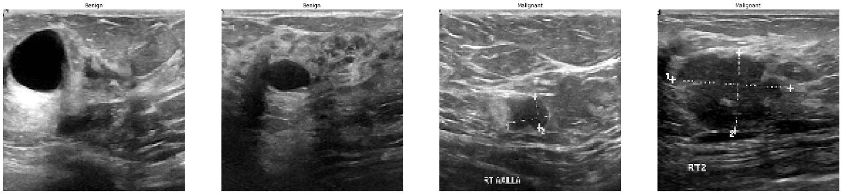
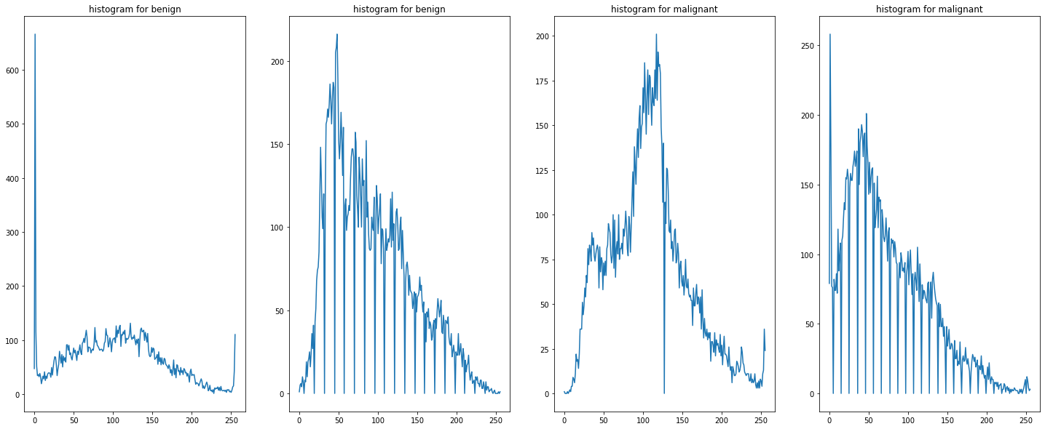
Image Preprocessing
Image Enhancement Methods
Grayscale Images

Slide 19
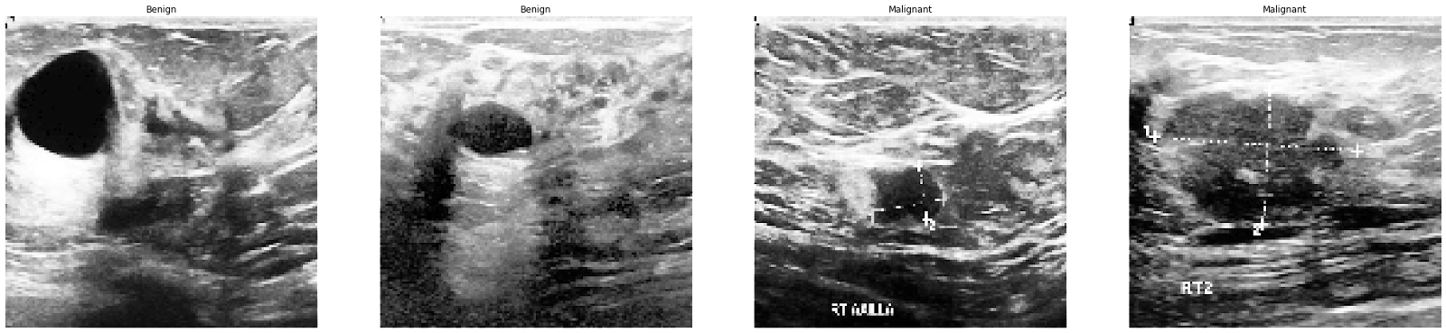
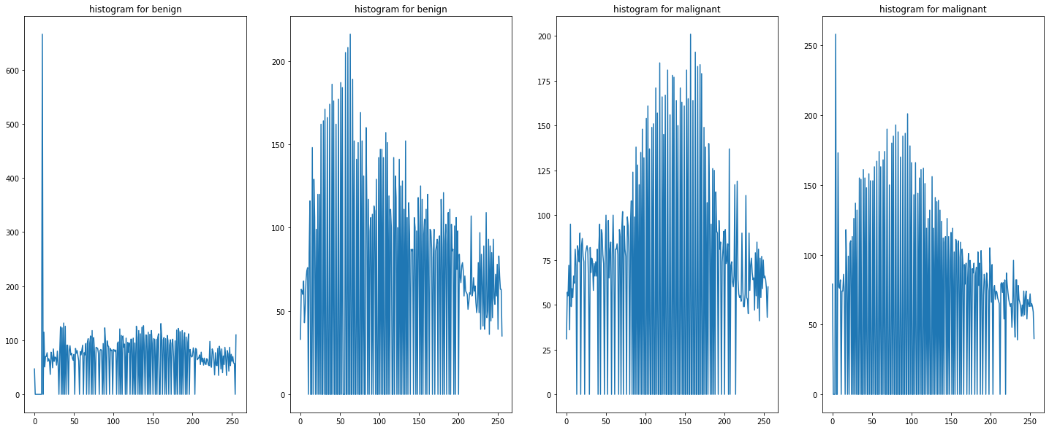
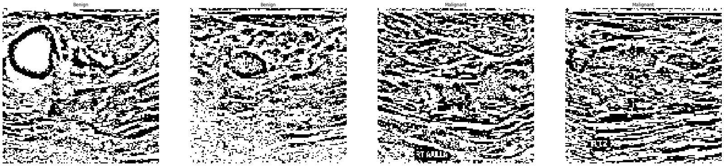
Histogram Equalization
Adaptive Histogram Equalization

Slide 20
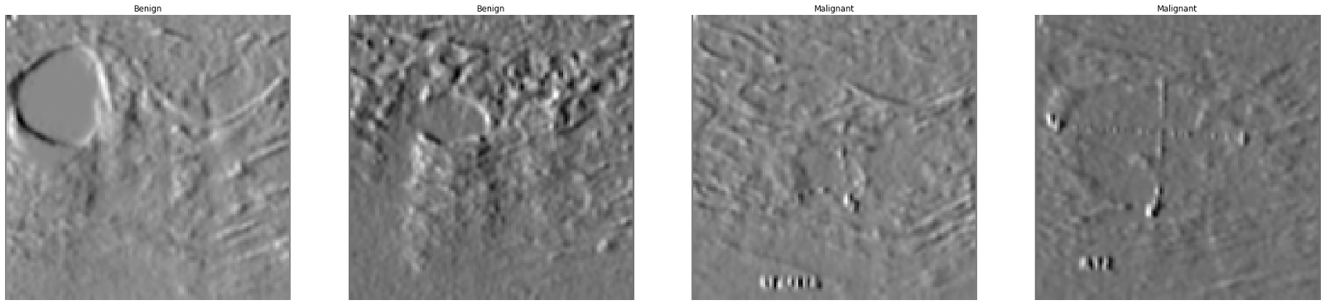
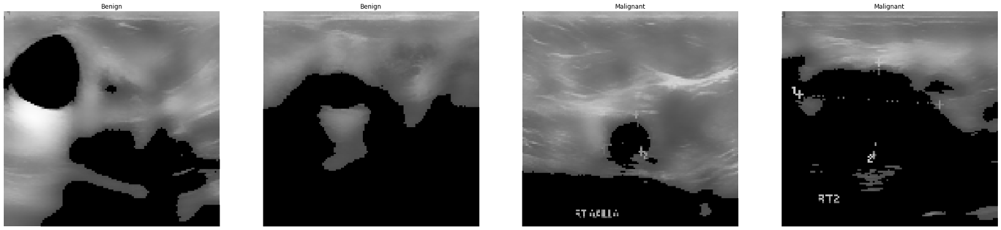
Sobel edge detection
Otsu’s Binarization

Slide 21
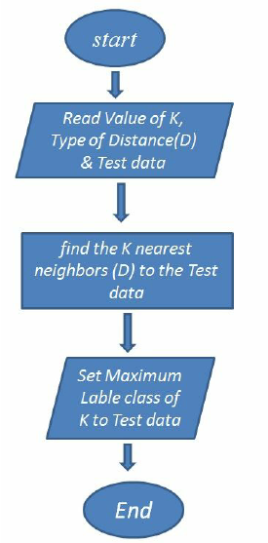
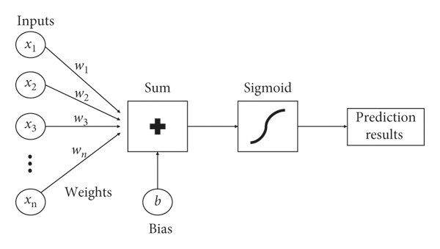
CLASSIFICATION USING MACHINE LEARNING
KNN Classifier
Logistic Regression:

Slide 22
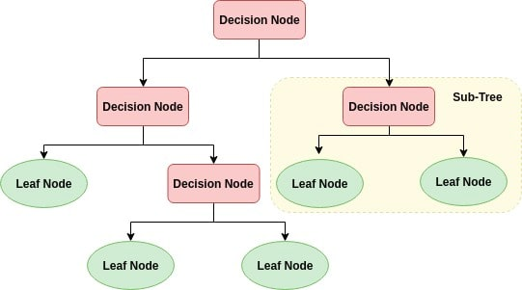
Decision Tree Classifier

Slide 23
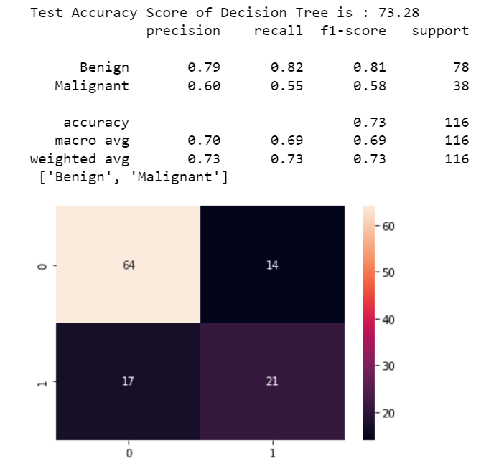

Slide 24
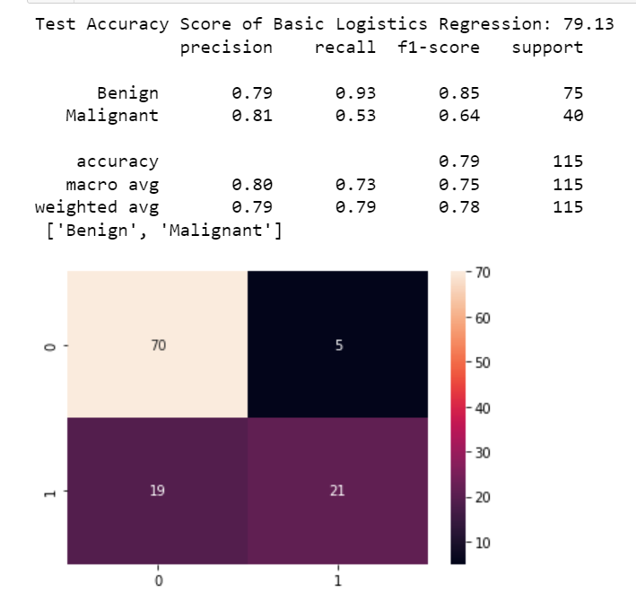
RESULTS:

Slide 25
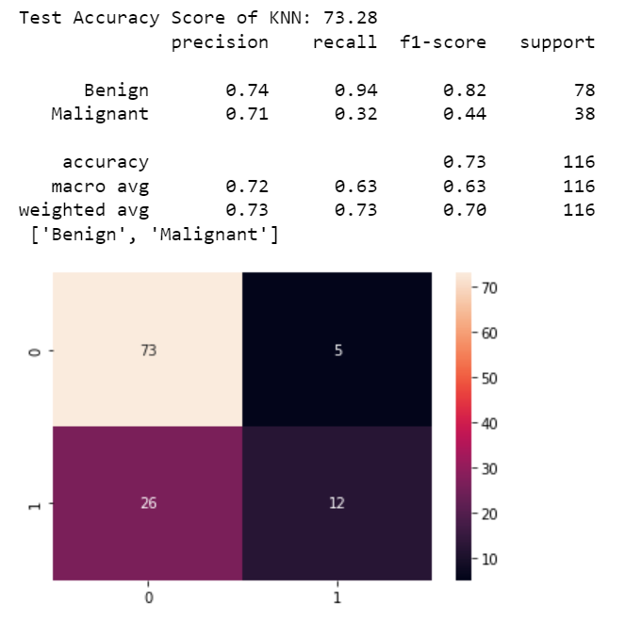

Slide 26
CONCLUSION:
We can conclude from our project that image preprocessing is a very essential step before performing tasks like segmentation and classification.
We can also conclude that preprocessing techniques like image enhancement and edge detection also have shown good results.
The Gray co-occurrence matrix(GLCM) features like energy , entropy, contrast, correlation, homogeneity etc performed a nice task to find relation between the pixels.
Applying Machine learning algorithms like Logistic Regression and KNN using features, showed average results.

Slide 27
REFERENCES
https://link.springer.com/chapter/10.1007/978-3-319-24574-4_28
https://ieeexplore.ieee.org/document/9302250
https://reader.elsevier.com/reader/sd/pii/S2352340919312181?token=5743E39 134AD964B3FF59190B2F0DBF022A8513A51E419C6A6A3E99B01A975E31B49998C88EB84952B0A4B193C10440C&originRegion=eu-west-1&originCreation=20220411190137

Slide 28
Thank You !!!!

